Slide 1
Value-laden implications of
AI in Military
STP514 Yunji Woo

Slide 2
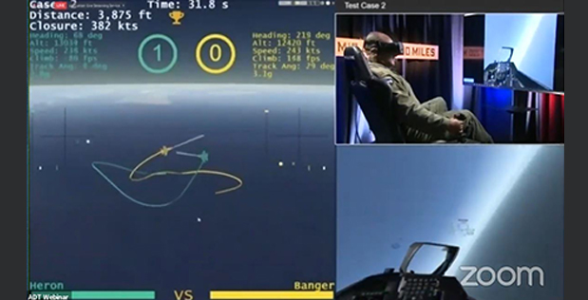
Introduction
Could science and technology be value-free in the considerations of military applications?
DARPA’s Air Combat Evolution(ACE) Program
Human pilot versus AI pilot dogfight
Airborne combat systems and concepts of human-machine interactions.
Alpha Dogfight Trials, DARPA
https://www.darpa.mil/news-events/2020-08-26

Slide 3
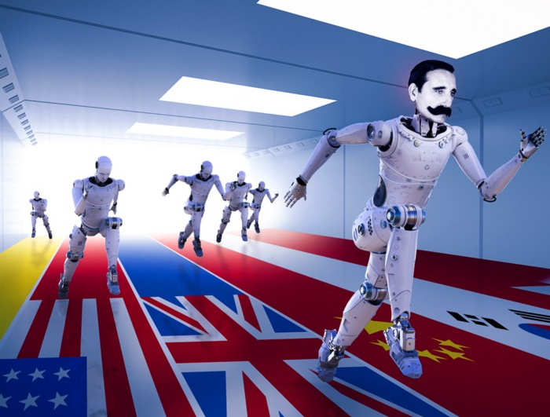
Non-epistemic values applied on Military AI
Cardwell’s Law
Concept of National Innovation System
1. Country’s population or economy will determine its national innovation rate
2. Military spending determines national innovation rates
Defense-related innovation consistently spills over into the civilian economy
Some S&T progress has flowed in reverse, from civilian to military from some countries in during Cold War period
Military spending and weapon production correlates with national innovation rates, lead geopolitical concepts of national S&T innovators to accelerate AI ARMS race.
3. First-mover advantages on some countries while others locking in competition.
4. Late industrialization explains national innovation rates
5. National culture matters
AI ARMS Race
https://medium.com/creation-being-human/who-will-win-the-ai-arms-race-187ac2ae8927

Slide 4
Inductive Risks of ARMS AI
Inductive risk
Consequence of direct and indirect ways that value could influence scientific reasoning, that affects on accepting or rejecting scientific hypothesis.
Hempel(1965) explains how inductive risk fits with other works on the legitimate uses of non-epistemic values in science, and how consideration of inductive risk can require the use of non-epistemic values.
Douglas(2000) inductive risk plays an ineliminable role in the evaluation of scientific hypotheses.

Slide 5
Inductive Risks of ARMS AI
Douglas(2000) implies the statistical significance levels and decisions of how to weigh evidence is responsible for scientists.
False positives
AI incorrectly identifies a threat or hostile action when there is none
Possible cases: recognize civilian as a threat
False negatives
AI system fails to identify a threat or hostile action when it is present
Possible cases: Could not identify friend or foe
The potential failures could lead dangerous situation, put soldiers and civilians at risk.

Slide 6
Inductive Risks of ARMS AI
To deal with inductive risks
Provide reliability through algorithm development
Provide evidence that the algorithm is safe
→ Train on diverse enough dataset, and interpret the data & algorithm
However, mission-oriented research could shifts the assessment of research from scientists to external factors.
Additional concerns about accountability, responsibility, and protection of human rights

Slide 7
Construction of ML
Training data is empirical element in machine learning model construction
Provides necessary empirical evidence for model without methodological choices.
Non-uniqueness of the solution of a given learning problem.
Preference bias (inductive bias)
A particular set of modelling assumptions chosen by developer reflects preferences
ML model construction is basically an estimation process based on inductive inference, the result of ML models always prone to error.
Training & Test error
Minimizing the training error serves to minimize inductive risk built in the model

Slide 8
Uncertainty of Data
Assessment of inductive risk is made through ‘uncertainty quantification’ giving quantitative estimates of the degree of uncertainty associated with the model. (Winsberg, 2012)
Accepting a particular model amount to risk of accepting its empirical consequence that can be erroneous.
Aleatory uncertainty
Inherent noise contained in the data cause uncertainty
Does not disappear just by acquiring a large amount of data
Homoscedastic uncertainty: Noise is constant for each type of input data
Heteroscedastic uncertainty: Noise is different for each input
Epistemic uncertainty
Model parameter
How confident the model is
Winsberg, E. (2012). Values and uncertainties in the predictions of global climate models. Kennedy Institute of Ethics Journal, 22, 111–137

Slide 9
Lack of explainability
‘Black box’
Multi-layered machine learning model as randomly applied initial values are gradually optimized through each layer of non-linear calculations
The algorithmic opacity entail epistemic opacity in the context of deep ML models
Transparency and opacity
Transparency is stakeholder dependent concept
Communication that intersect with technical design, law, and ethics
Judgement of transparency involve tradeoffs that reflect values

Slide 10
Operational risks in ARMS
Major values: Reliability, Fragility, and Security of AI system
Data
Automation biases in the development of the model
Defense security often make unable to use reliable data
Opacity in Decision-making
Adoption of AI raises concerns about shifting decision-making away from human.
The lack of explainability and inability to understand the determination process
Biddle, Justin B. “On Predicting Recidivism: Epistemic Risk, Tradeoffs, and Values in Machine Learning.” Canadian Journal of Philosophy, vol. 52, no. 3, Apr. 2022, pp. 321–41. Cambridge University Press, https://doi.org/10.1017/can.2020.27.

Slide 11
Conclusion
The role of value judgement in ML
The development and design of system requires human decisions that involve tradeoffs that reflect value
The assessment of inductive risk with respect to social values

Slide 12
References
Elliott, Kevin C. (2017), A Tapestry of Values: An Introduction to Values in Science, New York: Oxford University Press,
Douglas, Heather. “Inductive Risk and Values in Science.” Philosophy of Science, vol. 67, no. 4, 2000, pp. 559–79.
Coletta, Damon V. “The Politics of Innovation: Why Some Countries Are Better Than Others at Science and Technology. By Mark Zachary Taylor. Oxford: Oxford University Press, 2016. 444p. 27.95 Paper.” Perspectives on Politics, vol. 15, no. 3, Sept. 2017, pp. 807–09. Cambridge University Press
Elzinga, Aant. “Large-Scale Military Funding Induces Culture Clash.” Space Policy, vol. 6, no. 3, Aug. 1990, pp. 187–94. ScienceDirect
Elzinga, Aant. “The Science-Society Contract in Historical Transformation : With Special Reference to “Epistemic Drift” Social Science Information, vol. 36, no. 3, 1997, pp. 411–45.
Hilligardt, Hannah. “Looking beyond Values: The Legitimacy of Social Perspectives, Opinions and Interests in Science.” European Journal for Philosophy of Science, vol. 12, no. 4, Oct. 2022, p. 58. Springer Link
Schmid, Stefka, et al. “Dual-Use and Trustworthy? A Mixed Methods Analysis of AI Diffusion Between Civilian and Defense R&D.” Science and Engineering Ethics, vol. 28, no. 2, Mar. 2022, p. 12. Springer Link
Kendall, Alex, and Yarin Gal. What Uncertainties Do We Need in Bayesian Deep Learning for Computer Vision? arXiv:1703.04977, arXiv, 5 Oct. 2017. arXiv.org
Karaca, Koray. “Values and Inductive Risk in Machine Learning Modelling: The Case of Binary Classification Models.” European Journal for Philosophy of Science, vol. 11, no. 4, Oct. 2021, p. 102. Springer Link
Buckner, Cameron. “Deep Learning: A Philosophical Introduction.” Philosophy Compass, vol. 14, no. 10, 2019, p. e12625. Wiley Online Library
Biddle, Justin B. “On Predicting Recidivism: Epistemic Risk, Tradeoffs, and Values in Machine Learning.” Canadian Journal of Philosophy, vol. 52, no. 3, Apr. 2022, pp. 321–41. Cambridge University Press

